Slide 1
Valuing Higher Education
Dr. Albert W. Niemi, Jr.
Dean, Cox School of Business

Slide 2
1. The Payoff to Education
2. The Global Standing of the U.S. in Education
3. Changing Demographics in America
4. The Market for College Grads
5. The Changing Situation for Business Schools
6. Jobs in America
7. It's Good to be in Texas

Slide 3
The Payoff to Education

Slide 4
Table 1
Unemployment Rate by Education Level, 2011
(for full-time workers for 25 and over)
Education Level | Unemployment Rate
Doctoral Degree | 2.5%
Professional Degree | 2.4
Master's Degree | 3.6
Bachelor's Degree | 4.9
Associate Degree | 6.8
Some college – no degree | 8.7
High School Diploma | 9.4
Less than High School Diploma | 14.1
Source: Bureau of Labor Statistics

Slide 5
Table 2 Earnings by Education Level, 2010
Non-High School Grad | $21,004
High School Grad | $31,003
Associate Degree | $39,404
Bachelor's Degree | $57,621
Master's | $71,439
Doctorate | $106,840
Professional | $125,891

Slide 6
Table 3
Earnings by Race and Ethnic Background, 2010
 | White | Black | Asian | Hispanic
Non-H.S. | 21,839 | 17,415 | 20,491 | 20,856
High School | 32,067 | 25,757 | 28,579 | 26,381
Associate | 40,440 | 33,507 | 36,869 | 34,733
Bachelors | 59,188 | 44,311 | 57,183 | 47,980
Masters | 72,344 | 62,224 | 72,556 | 63,033
Doctorate | 108,594 | 97,820 | 101,170 | 95,104
Professional | 128,412 | 104,425 | 120,086 | 106,234

Slide 7
The Global Standing of the U.S. in Education

Slide 8
Table 4
High School Student Performance in Math and Science, 2009
Country | Math | Science | Total
Finland | 548 | 563 | 1,111
South Korea | 547 | 522 | 1,069
Canada | 527 | 534 | 1,061
Netherlands | 531 | 525 | 1,056
Japan | 523 | 531 | 1,054
Australia | 520 | 527 | 1,047
Belgium | 520 | 510 | 1,030
Germany | 504 | 516 | 1,020
United Kingdom | 495 | 515 | 1,010
Denmark | 513 | 496 | 1,009
Ireland | 501 | 508 | 1,009
Sweden | 502 | 503 | 1,005
Poland | 495 | 498 | 993
France | 496 | 495 | 991
Norway | 490 | 487 | 977
Spain | 480 | 488 | 968
United States | 474 | 489 | 963
Italy | 462 | 475 | 937
Greece | 459 | 473 | 932
Mexico | 406 | 410 | 816
Source: Statistical Abstract

Slide 9
Table 5
OECD Ranking for Reading, 2009
Country/Region | Score
1. China (Shanghai | 556
2. South Korea | 539
3. Finland | 536
4. Hong Kong | 533
5. Singapore | 526
6. Canada | 524
7. New Zealand | 521
8. Japan | 520
9. Australia | 515
10. Netherlands | 508
11. Belgium | 506
12. Norway | 503
13. Estonia | 501
13. Switzerland | 501
15. Iceland | 500
15. United States | 500
18. Lichenstein | 497
18. Germany | 497
18. Sweden | 497
Global Average | 493

Slide 10
Table 6
OECD Ranking for Mathematics, 2009
Country/Region | Score
1. China (Shanghai) | 600
2. Singapore | 562
3. Hong Kong | 555
4. South Korea | 546
5. China (Taipei) | 543
6. Finland | 541
7. Lichenstein | 536
8. Switzerland | 534
9. Japan | 529
10. Canada | 527
11. Netherlands | 526
12. China (Macao | 525
13. New Zealand | 519
14. Belgium | 515
15. Australia | 514
16. Germany | 513
17. Estonia | 512
18. Iceland | 507
19. Denmark | 503
20. Slovenia | 501
31. United States | 487
Global Average | 496

Slide 11
Table 7
OECD Ranking for Science, 2009
Country/Region | Score
1. China Shanghai) | 575
2. Finland | 554
3. Hong Kong | 549
4. Singapore | 542
5. Japan | 539
6. South Korea | 538
7. New Zealand | 532
8. Canada | 529
9. Estonia | 528
10. Australia | 527
11. Netherlands | 522
12. China (Taipei) | 520
12. Lichenstein | 520
12. Germany | 520
15. Switzerland | 517
16. United Kingdom | 514
17. Slovenia | 512
18. China (Macao) | 511
19. Poland | 508
19. Ireland | 508
23. United States | 502
Global Average | 501

Slide 12
Table 8
Percentage of Workforce with a College Degree, 1990 and 2000
Country | 1990 | 2000
United States | 23% | 28%
Australia | 10 | 19
Canada | 15 | 20
Finland | 10 | 15
France | 7 | 12
Germany | 10 | 13
Italy | 6 | 10
Japan | 13 | 19
South Korea | -- | 17
Spain | 9 | 17
Sweden | 12 | 17
United Kingdom | 9 | 18
Source: Statistical Abstract

Slide 13
Table 9
College Graduation Rates for 25-34 Year Olds, 2009 (% graduating)
Canada | 58%
Japan | 57
Russia | 57
South Korea | 57
New Zealand | 49
Ireland | 46
Norway | 43
Israel | 42
Belgium | 41
France | 41
Australia | 40
U.S. | 40
Denmark | 39
Finland | 39
Spain | 39
United Kingdom | 38
Netherlands | 37

Slide 14
Table 10
Ranking of the Top 50 Universities in the World
21 | United States
8 | United Kingdom
5 | China
3 | Japan
3 | France
3 | Canada
3 | Australia
2 | Singapore
1 | New Zealand
1 | Switzerland

Slide 15
Table 11
Number of Patents Granted, 2006-08
1. Japan | 141,203
2. U.S. | 82,284
3. South Korea | 80,688
4. China | 34,537
5. Taiwan | 33,402
6. Russia | 19,943
7. Germany | 13,691
8. France | 9,894
9. Italy | 5,257
10. Ukraine | 2,452
11. U.K. | 2,369
12. Spain | 2,086
13. Netherlands | 1,781
14. Canada | 1,761
15. Kazakhstan | 1,459
16. India | 1,385
17. Poland | 1,383
18. Sweden | 1,252
19. Australia | 978
20. Austria | 961
Source: The Economist

Slide 16
Changing Demographics in America

Slide 17
Table 12
High School Grads by Race and Ethnicity, 1960-2010
(% of population 25 and over)
High School Grad | White | Black | Asian | Hispanic | Mexican
1960 | 43.2 | 20.1 | 48.8 | - | -
1970 | 54.5 | 31.4 | 62.2 | 32.1 | 24.2
1980 | 68.8 | 51.2 | 74.8 | 44.0 | 37.6
1990 | 79.1 | 66.2 | 80.4 | 50.8 | 44.1
2000 | 84.9 | 78.5 | 85.7 | 57.0 | 51.0
2010 | 87.6 | 84.2 | 88.9 | 62.9 | 57.4
Source: U.S. Bureau of the Census

Slide 18
Table 13
College Grads by Race and Ethnicity 1960-2010
(% of population 25 and over)
College Grads | White | Black | Asian | Hispanic | Mexican
1960 | 8.1% | 3.1 | 11.3 | - | -
1970 | 11.3 | 4.4 | 20.4 | 4.5 | 2.5
1980 | 17.1 | 8.4 | 32.9 | 7.6 | 4.9
1990 | 22.0 | 11.3 | 39.9 | 9.2 | 5.4
2000 | 26.1 | 16.5 | 43.9 | 10.6 | 6.9
2010 | 30.3 | 19.8 | 52.4 | 13.9 | 10.6
Source: U.S. Bureau of the Census

Slide 19
Table 14
Hispanic Population Growth
 | Number | % of U.S. Total
1970 | 9.6 | 4.7
1980 | 14.6 | 6.4
1990 | 22.4 | 9.0
2000 | 35.3 | 12.5
2010 | 50.0 | 16.4
2020 | 65.0 | 19.5
2030 | 82.0 | 23.0
2040 | 98.0 | 26.2
2050 | 115.0 | 30.0

Slide 20
Table 15
Percent of White Income for Full Time Workers
 | Black | Hispanic | Asian
1990 | 77.6 | 71.7 | --
2000 | 80.3 | 67.6 | 104.2
2010 | 79.0 | 70.7 | 109.5

Slide 21
The Market for College Grads

Slide 22

.
Many With New College Degree Find the Job Market Humbling
The New York Times – May 18, 2011
Graduates at the University of Michigan commencement ceremony in Ann Arbor in April

Slide 23

53% of Recent College Grads Are Jobless or Underemployed – How?
A college diploma isn't worth what it used to be.
To get hired, grads today need hard skills.
The Atlantic – April 23, 2012

Slide 24
Is College Relevant?
53% of recent college grads are jobless or underemployed
Roughly half have no job or are working at a job that does not require a college degree
College grads with skills valued in the marketplace are doing well
College grads who do not meet the demands of the marketplace are struggling
Global competition is putting intense pressure on American companies, and the companies are looking for workers who can add value

Slide 25
The Changing Situation for
Business Schools

Slide 26
Decline in General Management MBA
Rise in Specialized Master's Programs
Master of Science in Accounting
MS Entrepreneurship
MS Finance
Masters in Management
Masters in Business Analytics
Undergraduate Majors in Finance
Alternative Assets
Energy Finance

Slide 27
Jobs in America

Slide 28
Table 16
America's Largest Employers, 1960 and 2010
 | 1960 | 2010
1. | General Motors | Wal-Mart
2. | U. S. Steel | Kelly Services
3. | General Electric | McDonalds

Slide 29
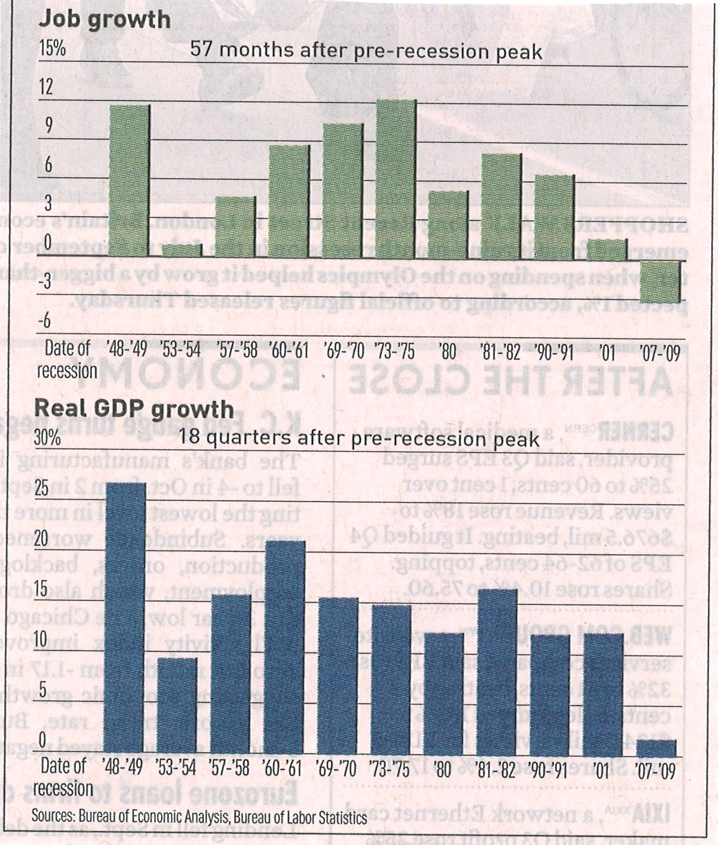
Figure 1
The Current Recovery in Perspective

Slide 30
Figure 2
Month-to-Month Change in Total Nonfarm Employment
Jobs lost in recession 8.4 million
Jobs gained in recovery 2.1 million
Jobs needed to get to 2007 employment 6.3 million
Job Growth in 2011 and 2012
 | 2011 | 2012
January | 110,000 | 275,000
February | 220,000 | 259,000
March | 246,000 | 143,000
April | 251,000 | 68,000
May | 54,000 | 87,000
June | 84,000 | 45,000
July | 96,000 | 181,000
August | 85,000 | 192,000
September | 202,000 | 132,000
October | 112,000 | 137,000
November | 157,000 | 161,000*
December | 223,000 | 155,000*
Net Jobs/month | 153,000 | 152,900
Unemployment rate 7.8%
Underemployment rate 17.6%
*Preliminary

Slide 31
Figure 3
Job Creation Path to Full Employment
Employment in 1000s
2025
2021
2018
+213,000 per month
2015
+244,000 per month
+301,000 per month
Full Employment
+503,000 per month
Actual Employment
2025

Slide 32
Figure 4
Auto Production by Country: 1961 to 2010
1,000s of vehicles

Slide 33
It’s Good to be in Texas

Slide 34
Figure 5
Job Gains and Losses by State:
2000-2012 (Sept.)
Delaware
South Carolina
Rhode Island
Tennessee
Massachusetts
New Jersey
Connecticut
Alabama
Mississippi
Wisconsin
Missouri
Indiana
Illinois
Ohio
Michigan

Slide 35
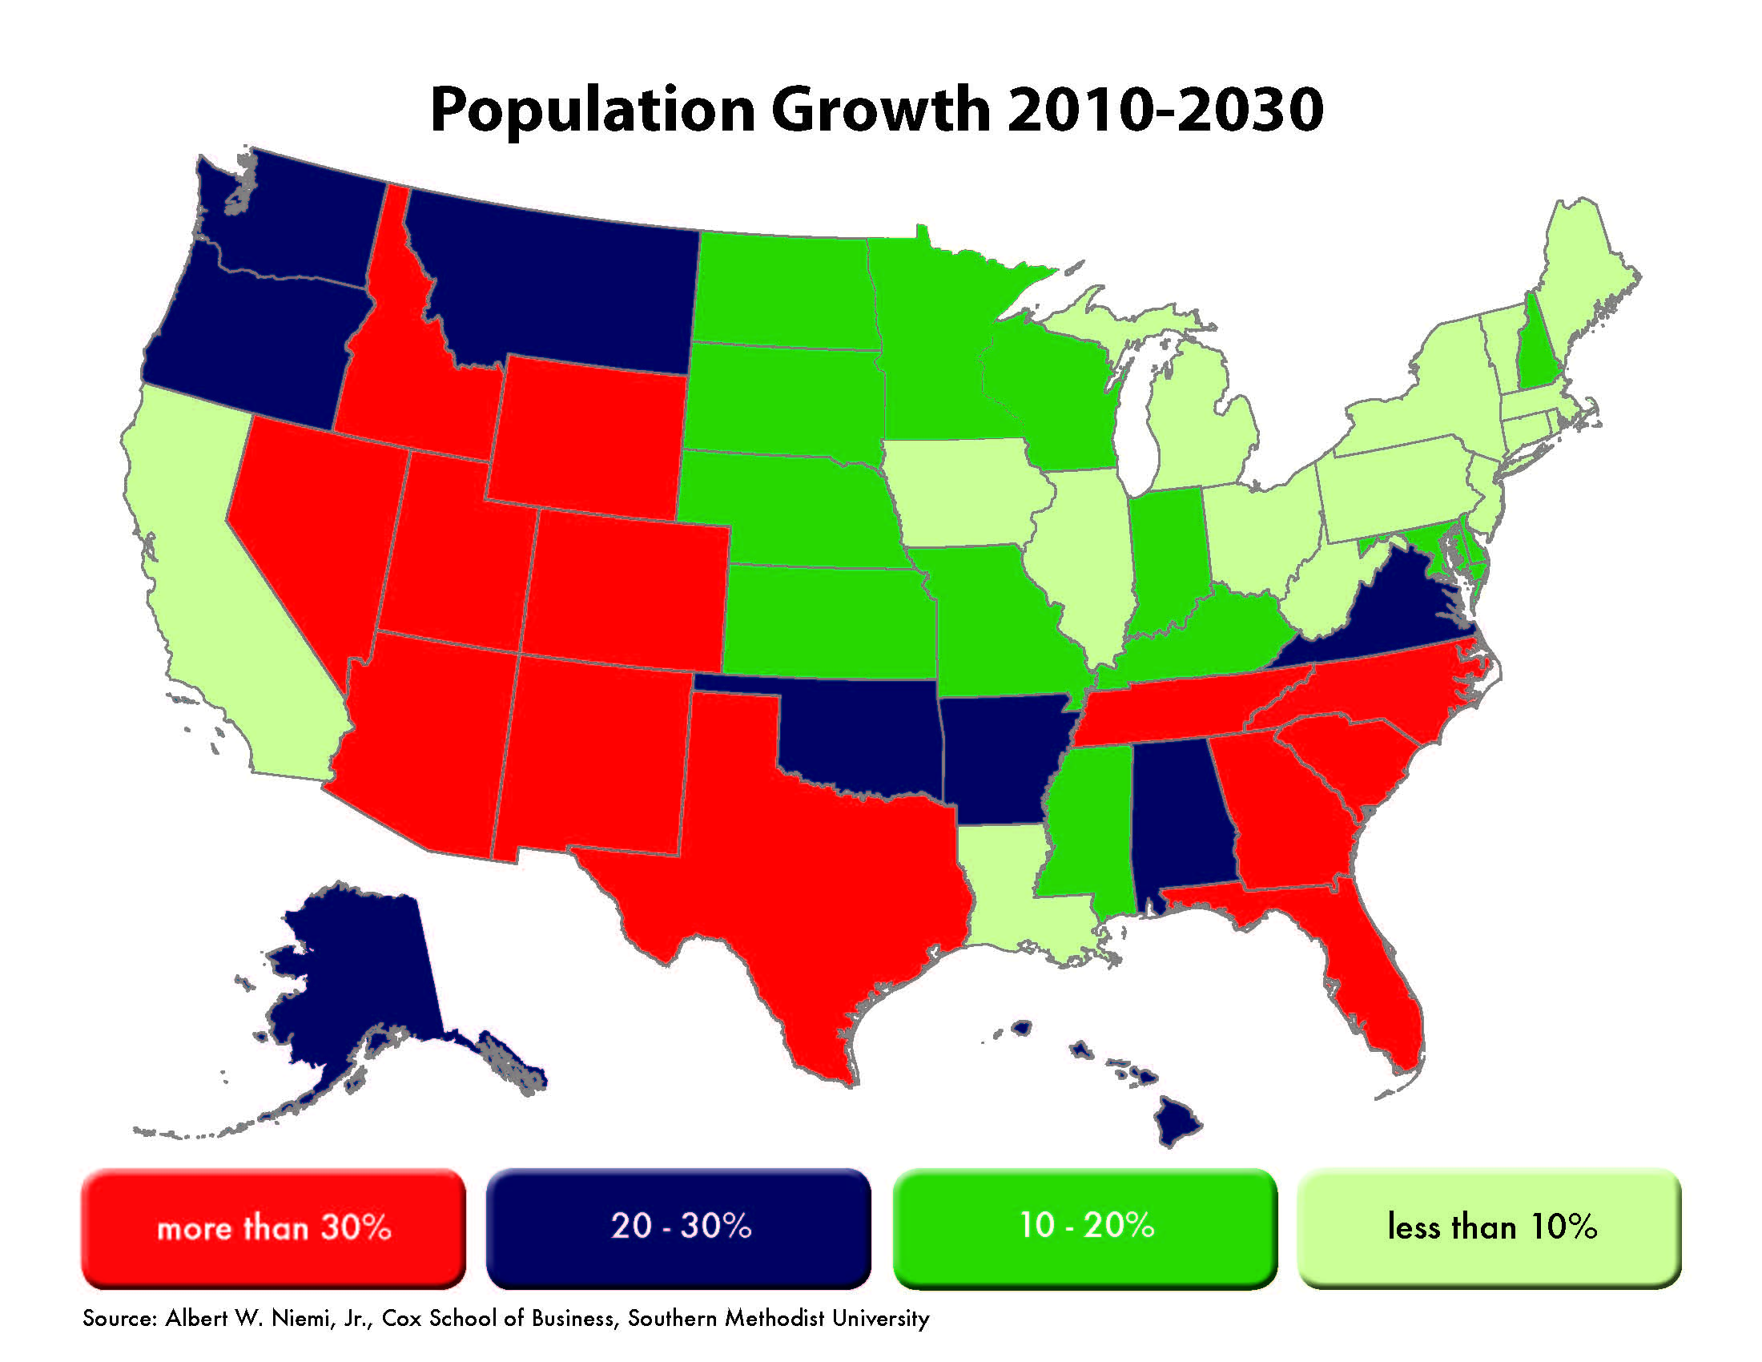
Figure 6

